Slide 1



INTRO TO PROGRAMMING WITH PYTHON
UZAIR JAWAID
SUMMER 2020

Slide 2
LECTURE 3
Loops, conditionals, and Functions
How we can simplify repetitive code without repeating ourselves to create efficient programs
The different types of loops (for-loop, do-while, while, etc.) and how to make decisions
More on arithmetic

Slide 3
LOOPS
A select few lines of code which repeat until a condition is met
Helps reduce lines of code and complexity of code
Makes our code more efficient
Useful for many cases such as storing data, searching through data, modifying data, etc.
If coded incorrectly, can cause some problems

Slide 4
LOOPS
There are 3 main types of loops
For loops, do-while loops, while loops
Python only has for loops and while loops
Each one has a condition and a code block and in most cases, an iterator
Iterator – a variable used to keep track of the number of times the code will/has loop(ed)
Condition – when the iterator meets the condition, the loop will come to a stop

Slide 5
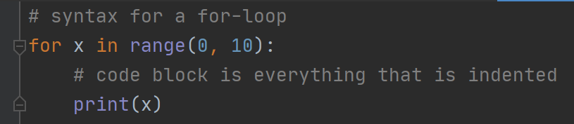
For loops
The code block will repeat for a set number of times
The syntax of a for loop is:
for <iterator variable> in range(start, end+1):
# do something
The range represents the starting value to count from, and the ending value to stop at
Note: the ending value is 1 number greater than the value the loop stops at
See example in demo

Slide 6
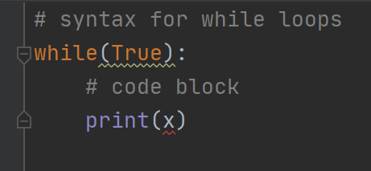
WHILE LOOPS
The code block will repeat while a condition is true
The syntax of a for loop is:
While(condition == True):
# do something
The condition can be any expression
We can also add an iterator which increments within the body of the loop
See demo

Slide 7
Conditionals and operators
Just like in math, we have operators to compare values
To check if two values are equal we use the double equal sign like a==b
Refer to the table for other comparisons
Comparison | Python Syntax
Equal | ==
Less than or equal to | <=
Greater than or equal to | >=
Less than | <
Greater than | >
Not equal | !=

Slide 8
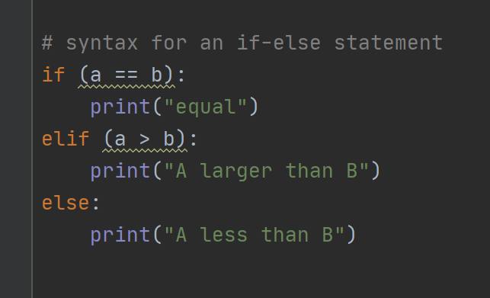
IF-ELSE STATEMENTS
IPO Decision Making Model
Code executes line by line and skips the code blocks where the conditions are not met
See demo

Slide 9
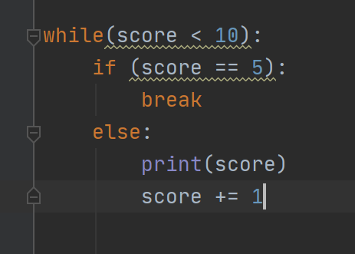
BREAK – TERMINATING A LOOP EARLY
If we want to terminate a loop based on another condition, we use the break command
The break will ignore any remaining iterations of the loop and continue to the code outside of the loop
Useful for more complicated algorithms and solving problems
There is also the continue keyword which skips the rest of the code block and continues to the next iteration of the loop

Slide 10
Functions/METHODS
Puzzle pieces of larger and more complex code
Reduce repetition of code and allows for reusability
The only difference between a function and a method is that functions return a value and methods are more so just procedures
Functions/Methods are given a name and parameters
Functions contain a return statement inside the code block

Slide 11
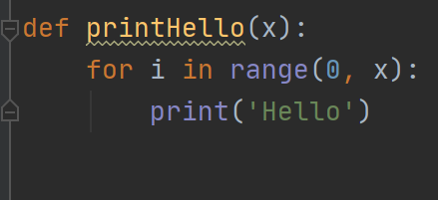
METHODS
This method will print hello to our console
It takes one parameter, which represents a variable storing how many times we want hello to be printed
When using methods, we’ll have a main method that acts as the entry point into the program

Slide 12
parameters
Parameters are like the bricks of a method or function
They can be “passed” into the method in two ways
By reference
By value
When passing by reference, we’re actually passing in the variable along with it’s memory location into the function – essentially the variable in it’s entirety
When passing by value, we’re only passing the value of the variable into the function
Think of this as passing a photocopy of the variable to the function

Slide 13
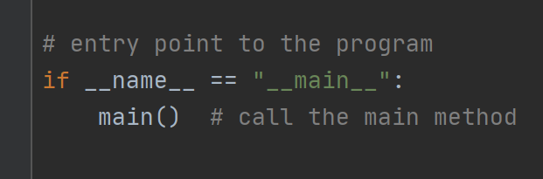
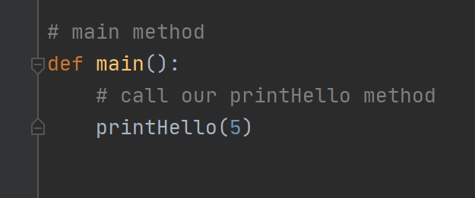
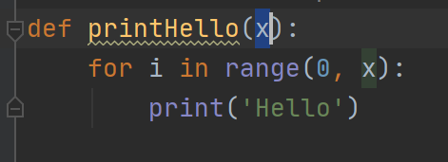
Piecing methods together
Python starts interpreting from __name__
__name__ calls the main method
All other methods are called inside of main
Other methods can be defined outside of main, and even inside of other methods
From GitHub:
Lecture 3: methods_and_functions.py

